Slide 1
Face Recognition Framework
Using Machine Learning

Slide 2



Face Recognition Framework
Module-1: Data Preprocessing (Embedding Features From Faces)
Module-2: Train features with Machine Learning Model
Module-3: Save Machine Learning model

Slide 3
Face Recognition Framework
Train Images
Train Machine Learning Model
Model Artifacts
image
image
images
Model Ready
Feature Embedding
&
Labeling
Data Preprocessing
Training
Save Model

Slide 4
Data Preprocessing
Collect data
Collect image of your friends, Family members, or celebrities
Segregate Images
Arrange Images of Faces in their respective folder
Embedding
&
Labeling
Extract Features using Face Descriptors
Label each Facial features by its name

Slide 5
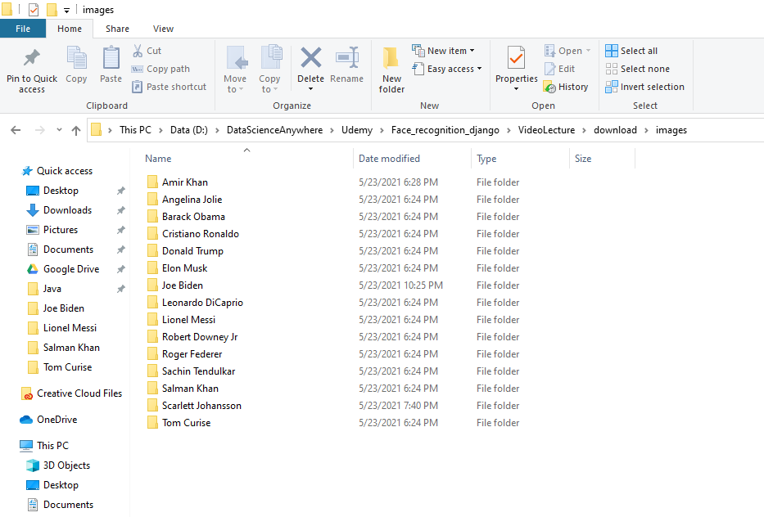
Data Preprocessing
Step-1:
It is highly recommended to collect the data by you own like you face of friends, family etc.
Make sure you collect at least 100 images of each person

Slide 6
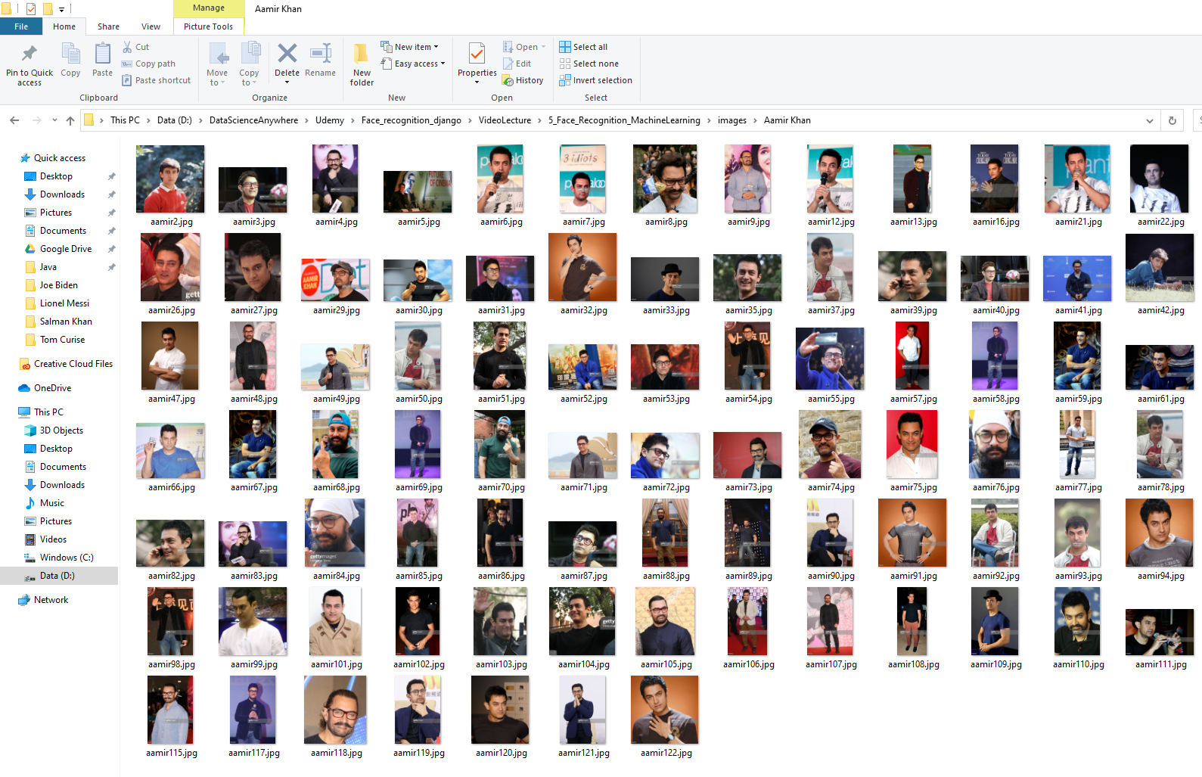
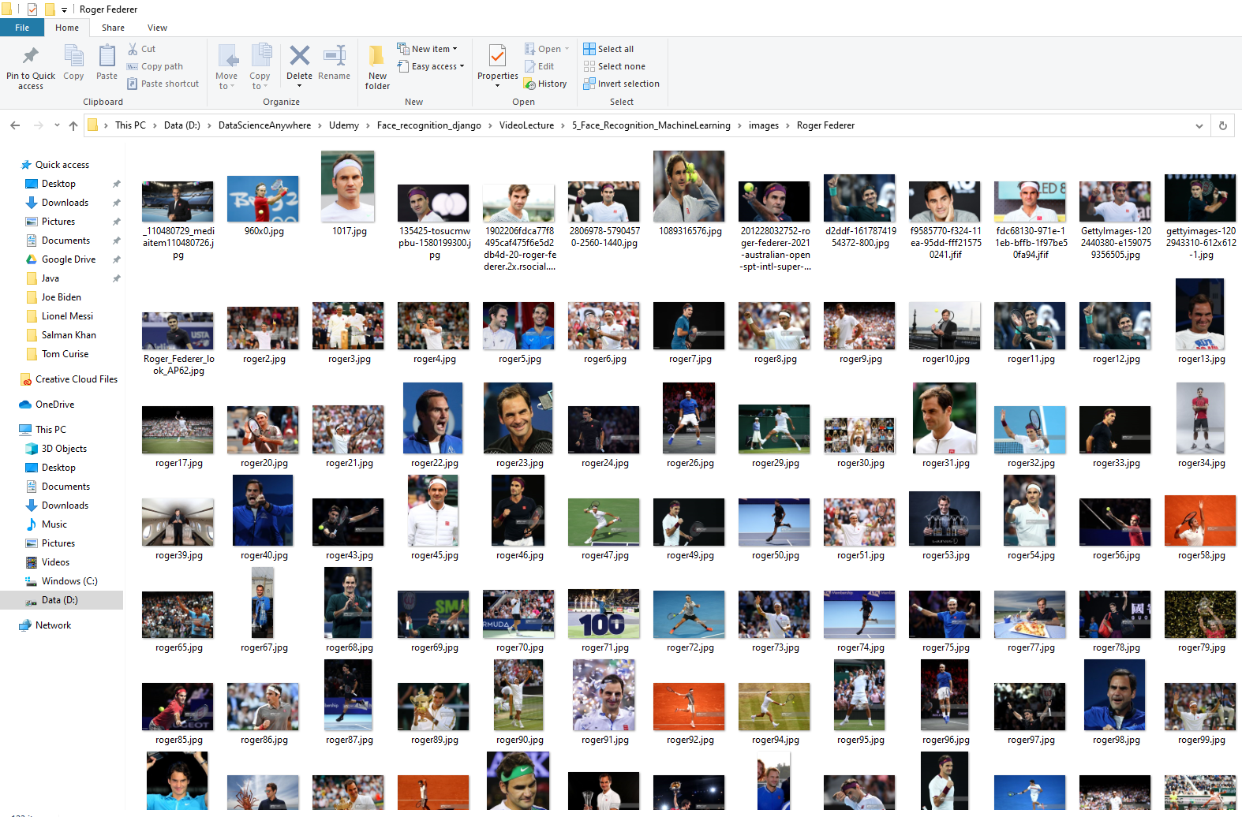
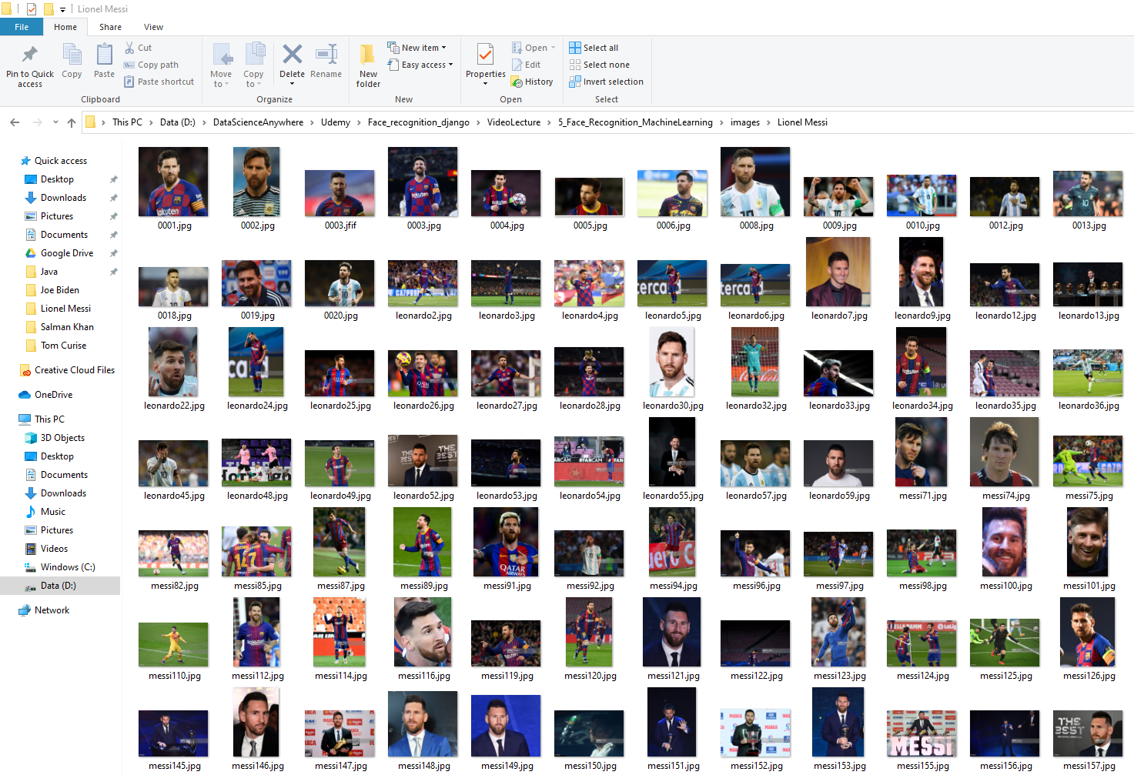
Data Preprocessing
Step-2:
Person face images should be saved in the respective folder
Aamir Khan
Roger Federer
Lionel Messi

Slide 7

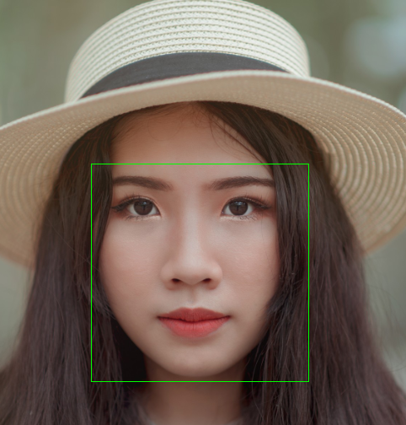

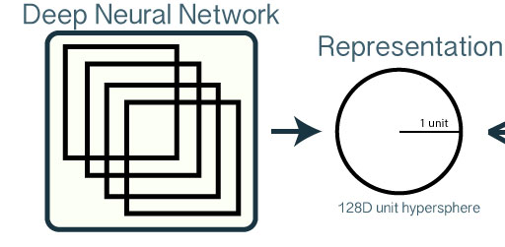
Step-3: Embedding Features
Step-2: Crop
Step-3:
Shape
Predictor
Step-1: Face Detection
Facial Features

Slide 8
Face Recognition Framework
Train Images
Train Machine Learning Model
Model Artifacts
image
image
images
Facial Features
Model Ready
Feature Extraction
Feature Extraction
Training
Save Model

Slide 9
Train Machine Learning Model
Test Set
Facial Features
Train Set
Evaluate Model
Model Ready
Data
Train ML model

Slide 10
Face Recognition Framework
Train Images
Train Machine Learning Model
Model Artifacts
image
image
images
Make Predictions
Model Ready
Feature Extraction
images
New Images
Feature Extraction
Training
Save Model

Slide 11
Next
Develop Machine Learning Based Face Recognition Model

